Slide 1
Carers Survey Feedback
Gill Owen-John and Aimee Teare
Adult Social Care – Stockport Council

Slide 2
Present Carer Specific Commissioning
Mental Health Carers Support
Providing carers assessments and support services for carers of people with mental health conditions
Young Carers and Young Adults Carers Support
Providing young carers assessments and support services for young carers aged up to 25
WIN Carers support
One worker providing specific support to carers around social engagement, volunteering and work
Carers assessment Pilot
One year pilot delivering carers assessments and support services for informal carers

Slide 3
Present generic commissioning
The Prevention Alliance
A range of services including information advice and guidance, and one to one work to address wellbeing
The Wellbeing and Independence Networks
WIN at Home
Practical support to help people remain safe and independent in their own homes
WIN Living Well in the Community
One to one and group support to help people engage with the community and reduce social isolation
WIN Community Transport
An enabling service to provide volunteer and accessible transport for those who are unable to use public transport

Slide 4
Issues with present commissioning
Insufficient investment into carer specific services
Inequity of provision – services provided for some groups of carers but not for others
Generic services refer on to specific services which are not funded to meet demand

Slide 5
Carers Consultation Survey Results

Slide 6
Consultation period
07/12/2020 04/01/2021
responses
Circulated via Commissioned partners, VCSE Group, team around the place, social media, CCG, Viaduct, Council comms

Slide 7
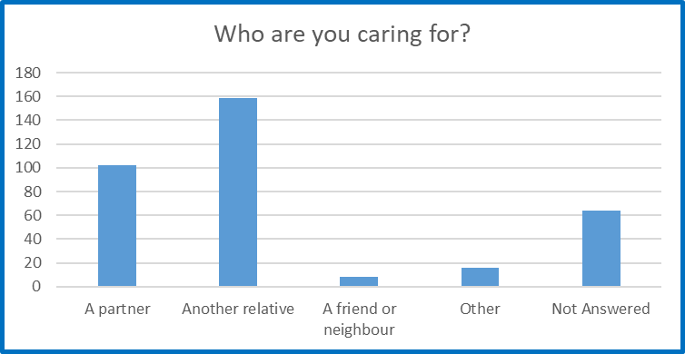
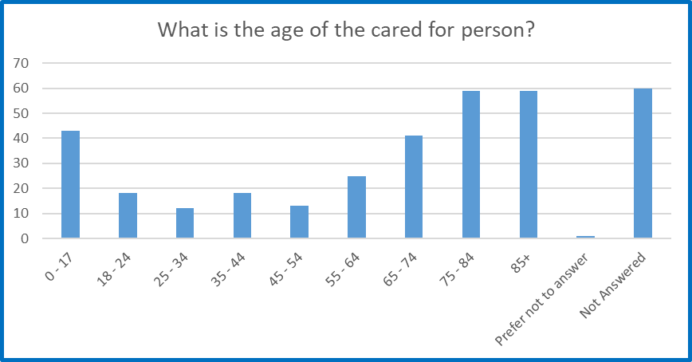
Survey Respondents

Slide 8
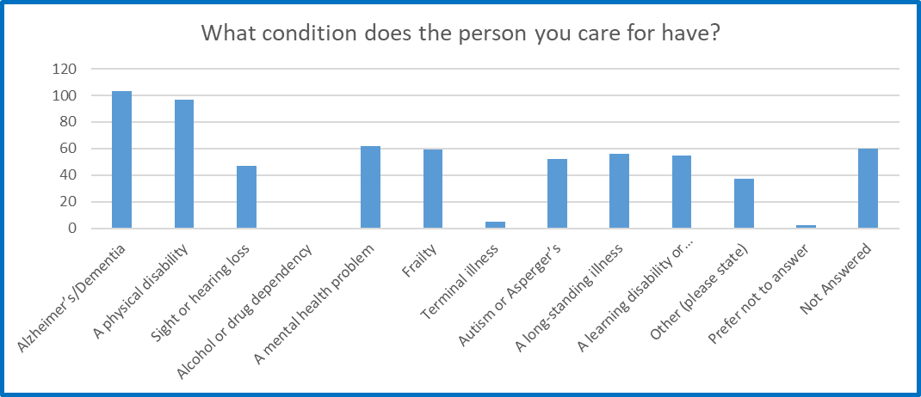
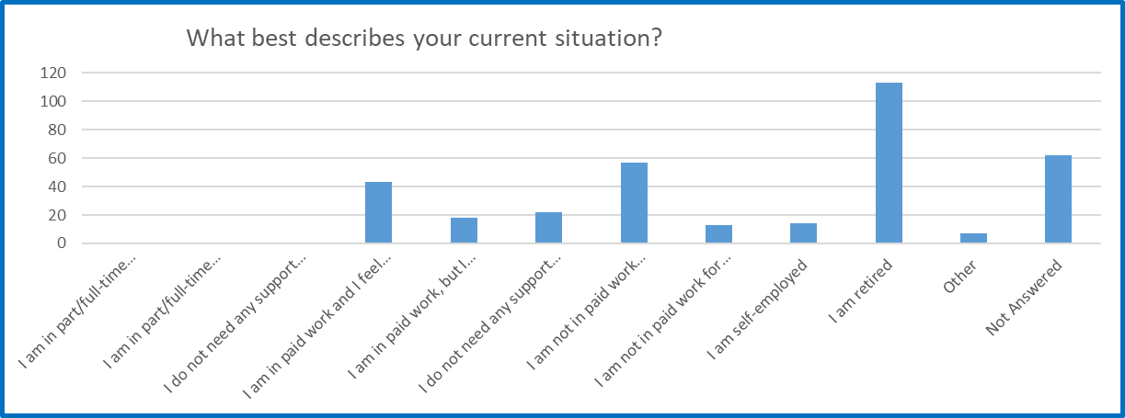

Slide 9
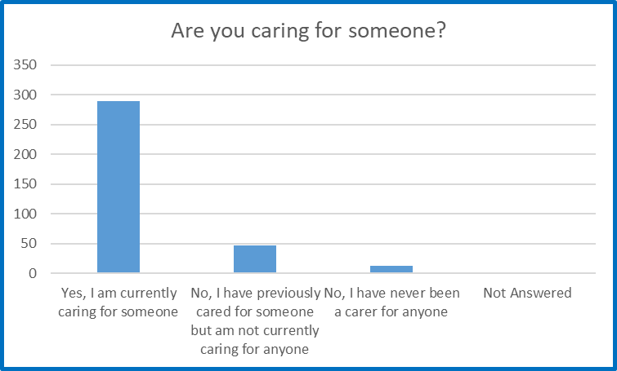
Are you currently caring for someone?
Are you currently caring for someone?
Yes I am currently caring for someone | 83%
No I have previously cared for someone but am not currently caring for anyone | 13%
No I have never been a carer | 4%

Slide 10
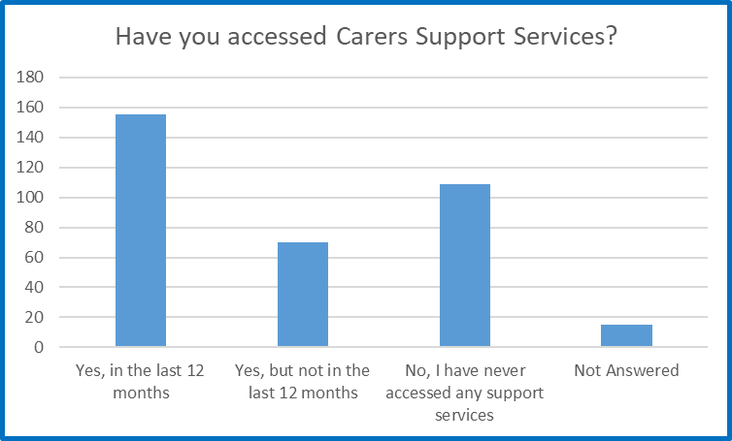
Have you accessed any carers support services?
Have you accessed any carer support services?
Yes, in the last twelve months | 44%
Yes but not in the last twelve months | 20%
No never accessed any support | 31%
Not answered | 4%

Slide 11
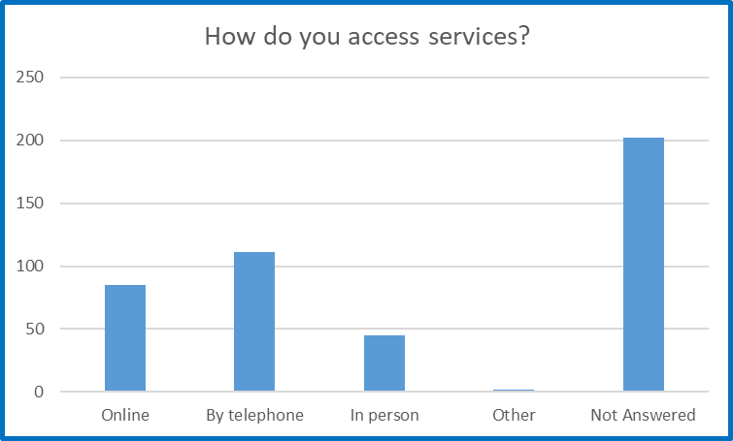
How do you access services?
How do you access services?
Online | 24%
Telephone | 32%
In person | 13%
Not answered | 58%

Slide 12
Accessing Support
Covid has meant that support has been on the phone. This is a little more tricky than face to face. Having said that, being able to get counselling by phone has given me more flexibility to access it as I don't need to arrange care for my daughter if I don't need to leave the house.
Yes, I was hoping to join the Carers drop in sessions in April but they stopped. I was eventually able to meet with the carers group via Zoom calls - which has been useful but not as good as face to face. Other support groups I attend have stopped too.

Slide 13
What has been most beneficial?
Counselling was very helpful as it gave the opportunity to talk about issues that I didn’t want to worry my family and friends about
Listening ear and offer of practical help
Availability of knowledgeable and professional staff who understand the challenges that face carers, to help you find appropriate support, both emotional and financial
Someone at the end of the phone who knows and understands if I need help
Meeting other carers

Slide 14
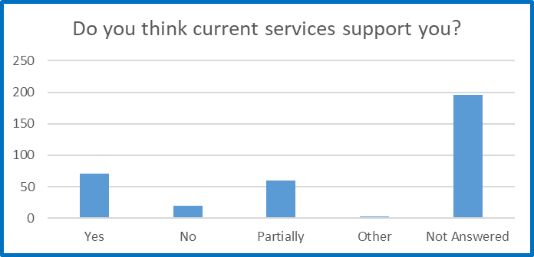
Do you think that current carers services support you in your caring role?
Do you think that current carers services support you in your caring role?
Yes | 20%
No | 5%
Partially | 17%
Not answered | 56%

Slide 15
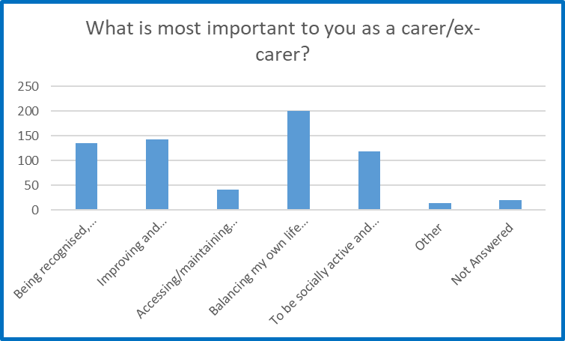
Priorities – what is most important to you?
Priorities as a Carer – what is most important to you?
Being recognised, acknowledged and valued as a carer | 39%
Improving and maintaining my personal health and wellbeing | 41%
Accessing/maintaining education or employment | 12%
Balancing my own life with my caring role | 57%
To be socially active and not become lonely or isolated | 34%
Other | 4%
Not answered | 5%

Slide 16
Priorities – what is most important to you?
They are all equally important to me
To get my daughter some sort of life, and know she will be able to cope when I’m not here
Making sure the person I care for is adequately looked after and that I access all services available for him
I find being a full time carer very demanding. Before the coronavirus we had respite at a care home. That gave me a rest and recovery. However with the virus we have not had that. Lack of visiting makes that worse
Financial support

Slide 17
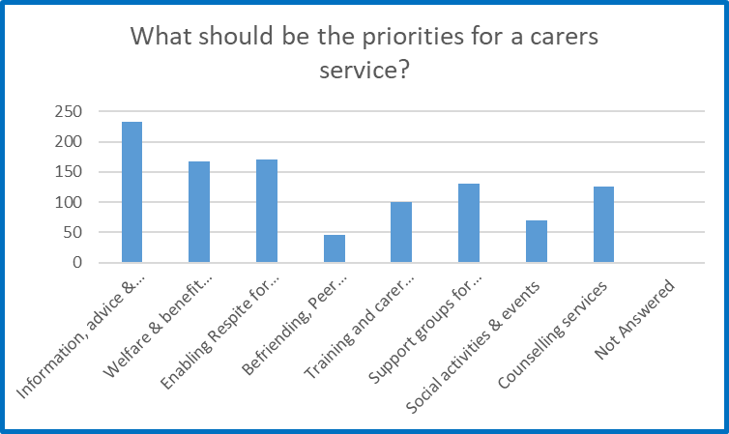
Priorities for services
Carers services and support – what are the priorities?
Information Advice and Guidance | 66%
Welfare Benefit Advice | 48%
Enabling respite for carers | 49%
Befriending, peer support and volunteering | 13%
Training and carer awareness for carers and professionals | 29%
Support groups for carers and ex carers | 38%
Social activities and events | 20%
Counselling | 36%
Not answered | 0.5%

Slide 18
Priorities for services - comments
There seem to be so many telephone numbers out there, but to have the one main contact from one organisation who listens, understands what being a carer is like and always assured with the correct information and advice has been invaluable to me
3 is not enough from this list – it is all absolutely essential and SO needed
Please don’t use the word “respite”, it’s offensive. It’s a short break from caring
A dedicated office where carers can go to get help

Slide 19
Priorities for services - comments
A one stop shop to access all information – navigating all the different agencies is complicated
All of the above may apply, you cannot really narrow it down. It’s so important not to put limits on what may or may not be needed
Very elderly people coping alone but with great difficulty are often forgotten; they do not always fit into the box of needing a structured care programme but do often need support alongside family.
Financial and practical help

Slide 20
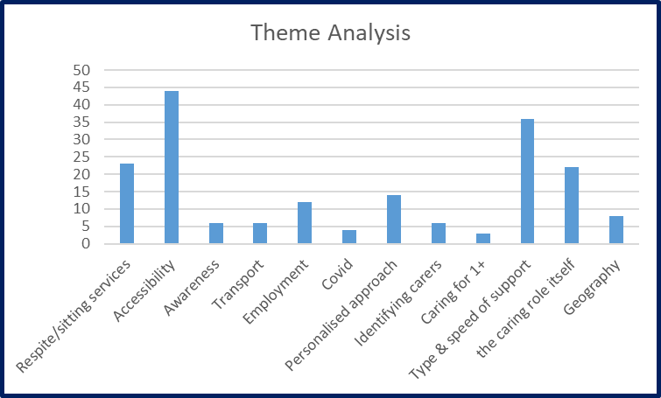
Challenges for Carers
Carers sometimes think that no one else is able to do what they do for their parent/spouse/child, and decline help
Being able to leave our cared for person with someone to care for them whilst we are out
Hard to get a job or live my own life because of my caring role. I don’t see family or friends, hard to maintain relationships or to get to appointments
Hidden carers- not everyone wants to identify as a carer and this needs to be acknowledged

Slide 21
Challenges for Carers
Use people who understand and have been there themselves, we need carer specific services, generic services don’t understand
There is no one central point of access, just a central point of avoidance. There are multiple organisations in Stockport doing a bit of this and a bit of that, someone needs to take overall umbrella responsibility for this, they are all funded from public money and many are overlapping
It is very hard to complain about your circumstances when caring for a loved one. It feels disloyal. It’s hard to ask for help.
DO NOT presume that everyone can access or do stuff online, DO NOT restrict provision to online access only.

Slide 22
Challenges for Carers
Being able to get out of the house, to go to the shops or appointments for myself. My partner can’t be left alone due to dementia and risk of falls, and is also now not very mobile, so this makes it difficult to navigate shops with him, particularly with social distancing measures in place. It’s difficult as I can’t leave him in the car as he gets confused and anxious
The cared for often resent carers having time for themselves, and make it difficult to access help and support groups.

Slide 23
Future Commissioning Plans
Have listened to carers feedback – commissioning plans have changed
2022 - Release funding from generic commissioning to allow increased investment into carer specific services
Ensure meet the needs of all unpaid carers across Stockport

Slide 24
Any Questions?

